Slide 1
Embedded Programming and Robotics
Lesson 8
Light Sensors and Temperature/Humidity

Slide 2
Analog Devices
These next two devices are by nature analog
You get a voltage that is the analog of some physical quantity, such as light intensity, temperature, or humidity

Slide 3
Light-Dependent Resistors
The LDR changes its resistance depending upon the level of light falling upon it
The more light, the lower the resistance
We can’t measure resistance directly, but we can measure the voltage drop caused by resistance

Slide 4
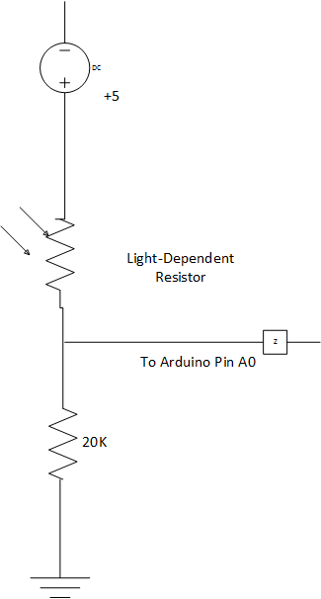
Light-Dependent Resistors
Basic circuit:
The resistor shown can be any value from 15K to 20K
You’ll get readings on A0 that range from 10 in near-darkness to 900 in bright light

Slide 5
Light-Dependent Resistors
You must use one of the analog pins
Code to read this:
#define LIGHT A0
int light = analogRead(LIGHT);

Slide 6
Light-Dependent Resistors
Connect up the circuit as shown
Determine the reading using the serial monitor
Cover the LDR and see what reading you get
You can use the multimeter to see the “raw” readings of resistance in varying light levels

Slide 7
Robot that Hides from Light
Add three light sensors to the front of your robot, spaced at intervals, one pointing straight ahead and the other two at about a 15-degree angle from straight ahead
You may need to put cardboard or paper between the sensors so each one operates independently
Write a program that reads the light level from all three and turns in the direction with the lowest reading until the levels are within about 20 of each other, then goes forward

Slide 8
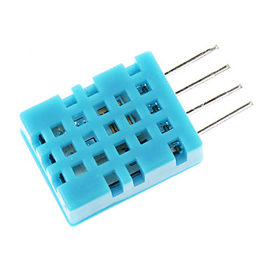
Temperature and Humidity
The DHT11 is a small sensor that reads both temperature and humidity
You can get the library here:
http://playground.arduino.cc/main/DHT11Lib

Slide 9
Temperature and Humidity
Connect V_{cc} to +5
Connect ground
Connect signal (pin 2 on the DHT) to pin 2 on the Arduino
Pin 3 is not used

Slide 10
Temperature and Humidity
The DHT11 is slow
It can take up to 250 milliseconds to get a reading of temperature or humidity
The value can be up to 2 seconds old
Not very useful for quick response
Temperature is in degrees Celsius as integers, thus not very accurate
Humidity is relative, as a percentage 0 to 100

Slide 11
Temperature and Humidity
In your code, you’ll need the following lines:
#include <dht.h>
#define DHTPIN 2
The following creates a DHT object:
dht DHT;
You don’t need to do anything in the setup() function

Slide 12
Temperature and Humidity
You can determine that the DHT11 is online:
int result = DHT.read11(DHTPIN);
if (result == DHTLIB_OK)
Serial.println(“DHT sensor ok”);

Slide 13
Temperature and Humidity
Read the temperature:
float temp = DHT.temperature;
Read the humidity:
float humidity = DHT.humidity;

Slide 14
Programming Exercise
Write a program that reads the temperature at four different places in the room and reports back to the Pi, using Bluetooth
You may have the robot move for 10 seconds, stop and read, then turn a little, move, etc.
This works best in a room that gets some sun, so you may not get much difference

Slide 15
Infrared Sensor
The infrared sensor (not the passive infrared motion detector) gives you proximity information similar to the range finder
It has a fairly short range

Slide 16
Infrared Sensor
Test the sensor: Place the sensor on the breadboard and connect Vcc and ground
Connect A0 to an analog pin, say A6
Write a program to read the value using analogRead an show it on the serial monitor

Slide 17
Mechanical Assembly
Having done that, you’ll need to modify your robot. Since the sensor needs to point down, and it needs to be ahead of and outside of the wheels, you can use two pieces of cardboard to make “wings” for your robot
Attach the wings using tape. Make sure they’re reasonably rigid.
Make sure the wings are at least 5 cm outside of the wheels and at least 15 cm in front of the chassis

Slide 18
Mechanical Assembly
Attach an IR sensor to each wing, pointing down
Make sure they’re approximately the same distance from the top of the table
Use male-to-female jumpers to connect it to the board

Slide 19
Coding Hints
Use #define to define the left and right sensors. No guessing that A6 is left and A7 is right
Define a function that controls the motors and parameterize it
Do not have analogWrite function calls inline

Slide 20
Programming Exercise
Write an edge-follower program thus:
The robot will move in a straight line as long as neither sensor detects an edge
You detect an edge by “seeing” nothing in the sensor
If the robot detects an edge on the left, it moves right
If it detects an edge on the right, it moves left
If both sensors detect edges (a cliff) have it move side to side until it can move in a safe direction

Slide 21
Programming Exercise
The test for this exercise is for your robot to go all the way around a square table in both directions
Caution: It is easy to have your robot overcompensate for detecting an edge; don’t do this

