Slide 1
CS 1
Lesson 5
Loops and Files

Slide 2
Increment and Decrement Operators
++ is the increment operator. It adds one to a variable.
val++; is the same as val = val + 1;
++ can be used before (prefix) or after (postfix) a variable:
++val; val++;
-- is the decrement operator, similar in operation to ++.

Slide 3
Prefix and Postfix
++ and -- operators can be used in complex statements and expressions
In prefix mode (++val, --val) the operator increments or decrements, then returns the value of the variable
In postfix mode (val++, val--) the operator returns the value of the variable, then increments or decrements

Slide 4
Prefix vs. Postfix - Examples
int num, val = 12;
cout << val++; // displays 12,
// val is now 13;
cout << ++val; // sets val to 14,
// then displays it
num = --val; // sets val to 13,
// stores 13 in num
num = val--; // stores 13 in num,
// sets val to 12

Slide 5
How Increment and Decrement Work
Can be used in expressions:
result = num1++ + --num2;
Must be applied to something that has a location in memory. Cannot have:
result = (num1 + num2)++;
Can be used in relational expressions:
if (++num > limit)
pre- and post-operations will cause different comparisons

Slide 6
The while Loop
Loop: a control structure that causes a statement or statements to repeat
General format of the while loop:
while (expression)
statement;
statement; can also be a block of statements enclosed in { }

Slide 7
The while Loop – How It Works
while (expression)
statement;
expression is evaluated
if true, then statement is executed, and expression is evaluated again
if false, then the loop is finished and program statements following statement execute
The expression can be arbitrary complexity but must evaluate to true or false

Slide 8
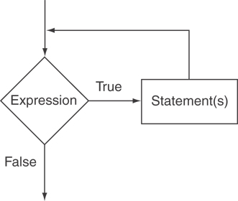
while Loop Logic

Slide 9
while Loop Example
unsigned char ch = 31;
while(static_cast<unsigned int>(ch++) != 255)
{
cout << static_cast<unsigned int>(ch) << " = " << ch << endl;
}

Slide 10
The while Loop is a Pretest Loop
expression is evaluated before the loop executes. The following loop will never execute: int number = 6; while (number <= 5) { cout << "Hello\n"; number++; }

Slide 11
Infinite Loops
The loop must contain code to make expression become false
Otherwise, the loop will have no way of stopping
Such a loop is called an infinite loop, because it will repeat an infinite number of times
(How do you stop one?)

Slide 12
Infinite Loop Example
int number = 1; while (number <= 5) { cout << "Hello\n"; }

Slide 13
The do-while loop
do-while: a posttest loop – execute the loop, then test the expression
General Format:
do
statement; // or block in { }
while (expression);
Note that a semicolon is required after (expression)

Slide 14
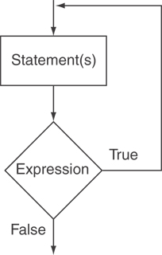
do-while Loop Logic

Slide 15
do-while Loop Example
int x = 1; do { cout << x << endl; } while(x < 0);
Although the test expression is false, this loop will execute one time because do-while is a posttest loop.

Slide 16
do-while Loop Notes
Loop always executes at least once
Execution continues as long as expression is true, stops repetition when expression becomes false
Useful in menu-driven programs to bring user back to menu to make another choice (see Program 5-8 on pages 245-246)

Slide 17
Input Validation with do-while
Programs should reject bad input. You can write a while loop to request input until the user enters something valid. The menu in the test program does this.
The advantage over what the text shows is that you don’t need your prompt and input twice.

Slide 18
Input Validation with do-while
char ch = ' ';
do
{
cout << "Enter an upper-case letter: ";
cin.get(ch);
} while (ch <'A' || ch >'Z');

Slide 19
The for Loop
Useful for a counter-controlled loop
General Format:
for(initialization; test; update)
statement; // or block in { }
No semicolon after the update expression or after the )

Slide 20
for Loop - Mechanics
for(initialization; test; update)
statement; // or block in { }
Perform initialization
Evaluate test expression
If true, execute statement
If false, terminate loop execution
Execute update, then re-evaluate test expression

Slide 21
The for Loop is a Pretest Loop
The for loop tests its test expression before each iteration, so it is a pretest loop.
The following loop will never iterate: for (count = 11; count <= 10; count++) cout << "Hello" << endl;

Slide 22
for Loop - Example
int count;
for (count = 1; count <= 5; count++)
cout << "Hello " << count << endl;
This displays:
Hello 1
Hello 2
Hello 3
Hello 4
Hello 5

Slide 23
Example Details
First, initialize count to 1
Second, test to see if count is less than or equal to 5
If it is, execute the body of the loop
If not, end the loop
The first time through, count is 1, so the statement outputs Hello 1
Go back to the top, perform the update expression, and test again.

Slide 24
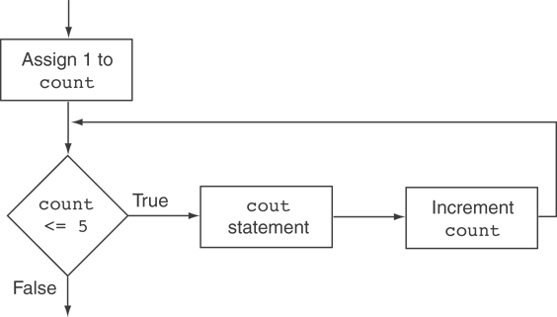
Example Flowchart

Slide 25
When to Use the for Loop
In any situation that clearly requires
an initialization
a false condition to stop the loop
an update to occur at the end of each iteration

Slide 26
for Loops Can Be Tricky
Consider the following code
int ix;
for (ix=0; ix<10; ix++);
cout << “ix = “ <<ix;
What gets displayed?
ix = 10

Slide 27
for Loop - Variations
You can have multiple statements in the initialization expression. Separate the statements with a comma: int x, y; for (x=1, y=1; x <= 5; x++) { cout << x << " plus " << y << " equals " << (x+y) << endl; }

Slide 28
for Loop - Variations
You can also have multiple statements in the update expression. Separate the statements with a comma: int x, y; for (x=1, y=1; x <= 5; x++, y++) { cout << x << " plus " << y << " equals " << (x+y) << endl; }

Slide 29
for Loop - Variations
You can omit the initialization expression if it has already been done:
int sum = 0, num = 1;
for (; num <= 10; num++)
sum += num;

Slide 30
for Loop - Variations
You can declare variables in the initialization expression:
int sum = 0;
for (int num = 0; num <= 10; num++)
sum += num;
The scope of the variable num is the for loop. It is undefined outside the loop.

Slide 31
Which Loop Do I Use?
The while loop is a conditional pretest loop
Iterates as long as a certain condition exits
Validating input
Reading lists of data terminated by a sentinel
The do-while loop is a conditional posttest loop
Always iterates at least once
Repeating a menu
The for loop is a pretest loop
Built-in expressions for initializing, testing, and updating
Situations where the exact number of iterations is known

Slide 32
Sentinel Values
sentinel: value in a list of values that indicates end of data
Special value that cannot be confused with a valid value, e.g., -999 for a test score
Used to terminate input when user may not know how many values will be entered
Needed because the console (keyboard) has no end of file indicator

Slide 33
Sentinel Values -- Example
double avg = 0;
double total = 0;
double score;
int num = 0;
cout << "Enter -1 to end entry of test scores" << endl;
while (true)
{
cout << "Enter a score: ";
cin >> score;
if (score < 0)
break;
total += score;
num++;
}
cout << "Average of " << num << " scores is " << (total / num) << endl;

Slide 34
Nested Loops
A nested loop is a loop inside the body of another loop
Inner (inside), outer (outside) loops:
for (row=1; row<=3; row++) //outer
for (col=1; col<=3; col++)//inner
cout << row * col << endl;

Slide 35
Notes on Nested Loops
Inner loop goes through all repetitions for each repetition of outer loop
Inner loop repetitions complete sooner than outer loop
Total number of repetitions for inner loop is product of number of repetitions of the two loops.

Slide 36
Using Files for Data Storage
You can use files instead of keyboard, monitor screen for program input, output
This allows data to be retained between program runs
Steps:
Open the file
Use the file (read from, write to, or both)
Close the file

Slide 37
Using Files
Use fstream header file for file access
File stream types:
ifstream for input from a file
ofstream for output to a file
fstream for input from or output to a file
Define file stream objects:
ifstream infile;
ofstream outfile;

Slide 38
Opening Files
Opening a file creates a link between file name (outside the program) and file stream object (inside the program)
Use the open member function:
infile.open("inventory.dat");
outfile.open("report.txt");
Filename may include drive, path info.
Output file will be created if necessary; existing file will be erased first
Input file must exist for open to work

Slide 39
Testing for File Open Errors
Can test a file stream object to detect if an open operation failed:
infile.open("test.txt");
if (!infile)
{
cout << "File open failure!";
}
Can also use the fail member function

Slide 40
Using Files
You can use an output file object and << to send data to a file:
outfile << "Inventory report";
You can use an input file object and >> to copy data from file to variables:
infile >> partNum;
infile >> qtyInStock >> qtyOnOrder;

Slide 41
Using Loops to Process Files
The stream extraction operator >> returns true when a value was successfully read, false otherwise
Can be tested in a while loop to continue execution as long as values are read from the file:
while (inputFile >> number) ...

Slide 42
Closing Files
Use the close member function:
infile.close();
outfile.close();
Don’t wait for operating system to close files at program end:
There may be a limit on number of open files
There may be buffered output data waiting to send to file

Slide 43
Specifying a File Name
The open member function requires that you pass the name of the file as a null-terminated string, which is also known as a C-string.
String literals are stored in memory as null-terminated C-strings, but string objects are not.

Slide 44
Specifying a File Name
string objects have a member function named c_str
It returns the contents of the object formatted as a null-terminated C-string.
Here is the general format of how you call the c_str function:
stringObject.c_str()

Slide 45
Sample Code
char strFilename[256];
char strLine[256];
ifstream infile;
while (true)
{
cout << "Enter file name: ";
cin.getline(strFilename, sizeof(strFilename));
infile.open(strFilename);
if (infile)
break;
}
while (infile.getline(strLine, sizeof(strLine)))
{
cout << strLine << endl;
}

Slide 46
Breaking Out of a Loop
You can use break to terminate execution of a loop
Use sparingly if at all – makes code harder to understand and debug
When used in an inner loop, terminates that loop only and goes back to outer loop
See example on in the previous slide

Slide 47
The continue Statement
Can use continue to go to end of loop and prepare for next repetition
while, do-while loops: go to test, repeat loop if test passes
for loop: perform update step, then test, then repeat loop if test passes
Use sparingly – like break, can make program logic hard to follow

