Slide 1
CS1 Lesson 2
Introduction to C++

Slide 2
Parts of a C++ Program
// sample C++ program
#include <iostream>
using namespace std;
int main()
{
cout << "Hello, there!";
return 0;
}

Slide 3
Notes:
Preprocessor directives begin with # (pound sign).
For #include, the file name is in brackets if it is one of the standard headers, in quotes if it is one of yours.

Slide 4
The cout Object
Displays output on the screen (the stdout device)
Use the << (stream insertion) operator.
You can string these together:
cout << “The values is” << x;

Slide 5
The endl Manipulator
endl (end line) makes the stream go to a new line.
cout << “First line” << endl << “second line”;
Note that the last character is the lower-case letter “L”, not the digit “1”.
(You can also use \n in a string:
cout << “First line\nSecond line”;
We’ll discuss other manipulators later.

Slide 6
The #include Directive
Any line that starts with a # sign is not an actual C++ statement. It directs the compiler to do something.
#include directs the compiler to include a source file as though you had typed it in line.
There is no semicolon at the end of this directive.

Slide 7
Variables
Variable: a storage location in memory
Has a name and a type of data it can hold
Can be changed by your program
Must be defined before it can be used:
int item;
item = 1;

Slide 8
Literals
A value (including strings) written into the program code.
Examples:
“Hello World” // string
3.14159 // double
‘z’ // char
Avoid using literals. They can make your program inflexible.

Slide 9
Identifiers
Any programmer-defined name, including the names of variables.
Function names, class names, etc. are identifiers.
C++ keywords cannot be used as identifiers

Slide 10
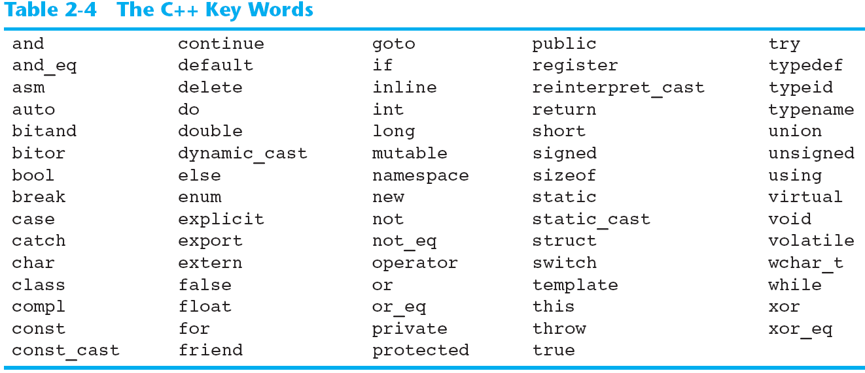
C++ Keywords

Slide 11
Identifier Rules
The first character must be a letter or an underscore (_)
After the first character you may use letters, numbers, and underscores
Upper- and lower-case letters are distinct.

Slide 12
Identifier Conventions
Identifiers for methods and variables generally begin with a lower-case letter. If contains more than one word, the second word is capitalized: itemsOrdered; totalSalesTax
Class names begin with a capital letter.
Named constants are usually all upper case:
const double PI = 3.1415926535;
Avoid single-letter identifiers in all but the simplest cases.

Slide 13
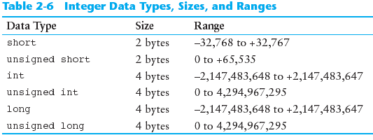
Integer Data Types

Slide 14
Integers, continued
When you use an integer literal, it is by default stored as an int. To make it a long, follow the number with ‘L’:
1234 is an int
1234L is a long.
Integer constants that begin with 0 (zero) are octal: 061. (089 is not valid)
Integer constants that begin with 0x are hexadecimal: 0xFF, 0x1A

Slide 15
The char Data Type
This represents a single character.
It can also be treated as an integer. You can do arithmetic on them.
In ASCII encoding, these take one byte of memory.
The numeric value of the character is stored:
char columnID = ‘A’; // stores 65
char row = ‘2’; // stores 50

Slide 16
Character Strings
A series of characters stored in memory is called a string. String literals are enclosed in quotes, and are stored with a binary zero (null) at the end.
“Hello” is stored as:

Slide 17
The C++ string class
Special data type supports working with strings
#include <string>
Can define string variables in programs:
string firstName, lastName;
Can receive values with assignment operator:
firstName = "George";
lastName = "Washington";
Can be displayed via cout
cout << firstName << " " << lastName;

Slide 18
Floating-Point Data Types
The floating-point data types are: float double long double
They can hold real numbers such as:
12.45 -3.8
Stored in a form similar to scientific notation
All floating-point numbers are signed

Slide 19
Floating Point

Slide 20
Floating Point Literals
Can be represented in
Fixed point (decimal) notation:
31.4159 0.0000625
E notation:
3.14159E1 6.25e-5
Are double by default
Can be forced to be float (3.14159f) or long double (0.0000625L)

Slide 21
The bool Data Type
Represents values that are true or false
bool variables are stored as small integers
false is represented by 0, true by 1:
bool bRun = true;
bool finished = false;

Slide 22
The Size of a Data Type
The sizeof operator gives the size of any data type or variable:
double amount;
cout << "A double is stored in "
<< sizeof(double) << "bytes\n";
cout << "Variable amount is stored in "
<< sizeof(amount)
<< "bytes\n";

Slide 23
Assignment
An assignment statement uses the = operator to store a value in a variable. item = 12;
long fedDeficit= 1000000000000L;
This statement assigns the value 12 to the item variable.

Slide 24
Variable Initialization
To initialize a variable means to assign it a value when it is defined:
int length = 12;
Can initialize some or all variables:
int length = 12, width = 5, area;

Slide 25
Scope of Variables
The scope of a variable: the part of the program in which the variable can be accessed
A variable cannot be used before it is defined
int main()
{
cout << value; // Error
int value = 31;
}

Slide 26
Scope, continued
for (int iy=0; iy<10; iy++)
{
cout << iy;
}
cout << iy; // iy is out of scope here.

Slide 27
Arithmetic Operators
Used for performing numeric calculations
C++ has unary, binary, and ternary operators:
unary (1 operand) -5
binary (2 operands) 13 - 7
ternary (3 operands) exp1 ? exp2 : exp3

Slide 28
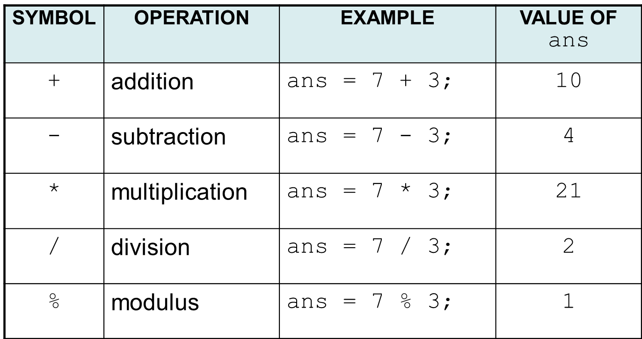
Binary Arithmetic Operators

Slide 29
Division
/ (division) operator performs integer division if both operands are integers
cout << 13 / 5; // displays 2
cout << 91 / 7; // displays 13
If either operand is floating point, the result is floating point
cout << 13 / 5.0; // displays 2.6
cout << 91.0 / 7; // displays 13.0

Slide 30
Modulus
% (modulus) operator computes the remainder resulting from integer division
cout << 13 % 5; // displays 3
% requires integers for both operands
cout << 13 % 5.0; // error

Slide 31
Comments
Use comments to explain to yourself and other programmers (including your instructor and TAs) what your program does.
The compiler ignores comments, so they don’t increase code size.
See the Web site for more notes on comments

Slide 32
Comment Types
A single-line comment is anything following a // (Unless the // is in quotes)
You can delimit comments with /* and */ and span multiple lines. You can also use this style within a line:
calculate(double rate, /* tax rate*/, double amount);

Slide 33
Named Constants
Use the “const” modifier to indicate that a variable really isn’t:
const int MAX_RECORDS = 100;
const double PI = 3.1415926535;
Use these in place of literals, especially if you use the value more than once.
Avoid using #define

Slide 34
Programming Style
Make your programs look visually pleasing and readable.
Use good naming conventions.
Common elements to improve readability:
Braces { } aligned vertically
Indentation of statements within a set of braces
Blank lines between declaration and other statements
Long statements wrapped over multiple lines with aligned operators

Slide 35
Standard and Prestandard C++
Older-style C++ programs:
Use .h at end of header files:
#include <iostream.h>
Use #define preprocessor directive instead of const definitions
Do not use using namespace convention
May not compile with a standard C++ compiler

